Slide 1
Distributed Concurrency Control
Chapter 11
Distributed Concurrency Control
Notes:
1

Slide 2
Centralized Transaction Execution
User
Application
…...
User
Application
Begin_transaction,
Read, Write, Commit, Abort
Transaction Manager
(TM)
Read, Write,
Commit, Abort
Results
Scheduler
(SC)
Scheduled Operations
Results
Recovery Manager
(RM)

Slide 3
Distributed Transaction Execution
User
Application
Begin_transaction,
Read, Write, Commit, Abort
Results &
User Notifications
TM
TM
Read, Write,
Commit, Abort
SC
SC
Scheduled Operations
RM
RM

Slide 4
Concurrency Control
The problem of synchronizing concurrent transactions such that the consistency of the database is maintained while, at the same time, maximum degree of concurrency is achieved.
Anomalies:
  Lost updates -- The effects of some transactions are not reflected on the database.
  Inconsistent retrievals -- A transaction, if it reads the same data item more than once, should always read the same value.

Slide 5
Execution Schedule (or History)
An order in which the operations of a set of transactions are executed.
A schedule (history) can be defined as a partial order over the operations of a set of transactions.
T₁ : Read(x) T₂ : Write(x) T₃ : Read(x)
Write(x) Write(y) Read(y)
Commit Read(z) Read(z)
Commit Commit
S₁ ={ W₂ (x), R₁ (x), R₃ (x), W₁ (x), C₁ ,W₂ (y), R₃(y), R₂(z), C₂ , R₃ (z), C₃ }

Slide 6
Formalization of Schedule
A complete schedule SC(T) over a set of transactions T = {T₁ , ..., T_{n} } is a partial order
SC(T) = { Σ_{T} , <_{T} }, where
1) Σ_{T} = ∪_{i} Σ_{i} , for i = 1, 2, ..., n
2) <_{T} ⊇ ∪_{i} < _{i} , for i = 1, 2, ..., n
3) For any two conflicting operations O_{ij}, O_{kl} ∈ Σ_{T} ,
either O_{ij} <_{T} O_{kl} or O_{kl} <_{T} O_{ij}

Slide 7
Complete Schedule -- Example
Given three transactions
T₁ : Read(x) T₂ : Write(x) T₃ : Read(x)
Write(x) Write(y) Read(y)
Commit Read(z) Read(z)
Commit Commit
A possible complete schedule is given as the DAG
R₁(x) W₂(x) R₃(x)
W₁(x) W₂(y) R₃ (y)
C₁ R₂(z) R₃(z)
C₂ C₃

Slide 8
Schedule Definition
A schedule is a prefix of a complete schedule such that only some of the operations and only some of the ordering relationships are included.
T₁ : Read(x) T₂ : Write(x) T₃ : Read(x)
Write(x) Write(y) Read(y)
Commit Read(z) Read(z)
Commit Commit
R₁(x) W₂(x) R₃(x)
W₁(x) W₂(y) R₃(y)
C₁ R₂(z) R₃(z)
C₂ C₃
R₁(x) W₂(x) R₃(x)
W₁(x) W₂(y) R₃(y)
R₂(z) R₃(z)

Slide 9
Serial Schedule
All the actions of a transaction occur consecutively.
No interleaving of transaction operations.
If each transaction is consistent (obeys integrity rules), then the database is guaranteed to be consistent at the end of executing a serial history.
T₁ : Read(x) T₂ : Write(x) T₃ : Read(x)
Write(x) Write(y) Read(y)
Commit Read(z) Read(z)
Commit Commit
S ={W ₂ (x), W ₂ (y),R ₂(z),C ₂ ,R ₁(x),W₁ (x), C ₁, R₃(x), R₃(y), R₃(z), C₃ }

Slide 10
Serializable Schedule
Transactions execute concurrently, but the net effect of the resulting schedule upon the database is equivalent to some serial schedule.
Equivalent with respect to what?
  Conflicting operations: two incompatible operations (e.g., Read and Write) conflict if they both access the same data item.
    Incompatible operations of each transaction is assumed to conflict; do not change their execution orders.
    If two operations from two different transactions conflict, the corresponding transactions are also said to conflict.
  Conflict equivalence: the relative order of execution of the conflicting operations belonging to unaborted transactions in two schedules are the same.

Slide 11
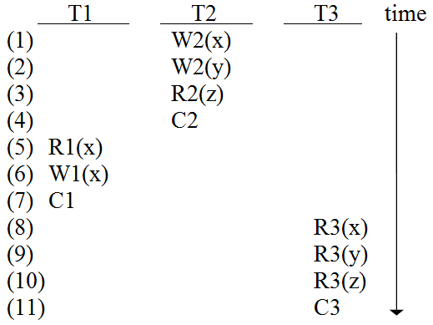
Serializable Schedule Example
A serial schedule for the three transactions
S = {W2(x),W2(y),R2(z),C2, R1(x),W1(x),C1,R3(x),R3(y),R3(z),C3}

Slide 12
Serializable Schedule Example (cont.)
T₁ : Read(x) T₂ : Write(x) T₃ : Read(x)
Write(x) Write(y) Read(y)
Commit Read(z) Read(z)
Commit Commit
The following is not conflict equivalent:
S = {W₂(x), W₂(y), R₂(z), C₂, R₁(x), W₁(x), C₁, R₃(x),
R₃(y), R₃(z), C₃ }
S₁ = {W₂(x), R₁(x), R₃(x),W₁(x), C₁, R₃(y), W₂(y), R₂(z),
C₂, R₃(z), C₃ }

Slide 13
Serializable Schedule Example (cont.)
T₁ : Read(x) T₂ : Write(x) T₃ : Read(x)
Write(x) Write(y) Read(y)
Commit Read(z) Read(z)
Commit Commit
The following is conflict equivalent, therefore, S₂ is serializable:
S = {W₂(x), W₂(y), R₂(z), C₂, R₁(x), W₁(x), C₁, R₃(x),
R₃(y), R₃(z), C₃ }
S₂ ={W₂(x), R₁(x), W₁(x), C₁, R₃(x), W₂(y), R₃(y), R₂(z),
C₂, R₃(z), C₃ }

Slide 14
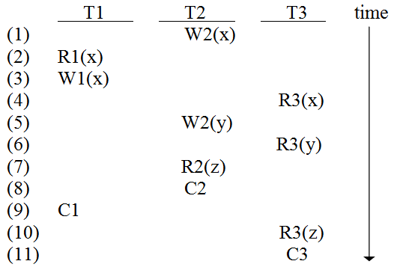
Serializable Schedule Example (cont.)
Serializable Schedule

Slide 15
Concurrency Control Algorithms
Pessimistic
  Two­ Phase Locking ­based (2PL)
    Centralized (primary site) 2PL
    Primary copy 2PL
    Distributed 2PL
  Timestamp Ordering (TO)
    Basic TO
    Multiversion TO
    Conservative TO
  Hybrid
Optimistic
  Locking­ based
  Timestamp ordering ­based

Slide 16
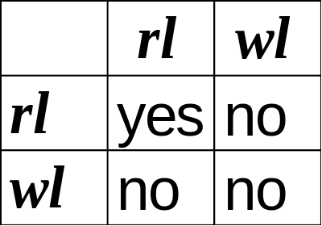
Locking-based Algorithms
Transactions indicate their intentions by requesting locks from the scheduler (called lock manager).
Locks are either read lock (rl) [also called
shared lock] or write lock (wl) [also called
exclusive lock]
Read locks and write locks conflict (because Read and Write operations are incompatible)

Slide 17
Lock-Based Strategy
A transaction locks an object before using it.
When an object is locked by another transaction, the requesting transaction (with an incompatible lock mode) must wait.
☞ Locking works nicely to allow concurrent
processing of transactions.

Slide 18
Basic Lock Manager Algorithm
LM receives DB operations and associated information (transaction ID etc.) from the TM, or a message from the data processor
Begin_transaction, Read, Write, Commit, Abort
Results
Distributed
Execution Monitor
Transaction Manager
(TM)
Scheduling/ Descheduling
Requests
other LMs
Scheduler
(SC/LM)
other TMs
In locking-based systems, scheduler (SC) is lock manager (LM).
To data processor

Slide 19
Basic LM Algorithm (cont.)
For a message from the TM, LM checks if the lu which contains the required data item is locked:
  If locked, and the locking mode is incompatible, then put the current operation on queue;
  Otherwise
    the lock is set in an appropriate mode, and
    database operation is passed onto the data processor, and then
    wait for messages from the data processor.
Locking granularity, i.e. the size of the portion of database that a lock is
applied. This portion is called locking unit (lu).

Slide 20
Basic LM Algorithm (cont.)
Upon the receipt of a message from the data processor:
  Release the lock on lu held by the transaction;
  Check, if there are no more locks on lu, and there are operations waiting in queue to lock lu, then
    SOP ← first operation from the queue;
    SOP ← SOP ∪ {O | O is an operation that can lock
    lu in a compatible mode with
    the current operations in SOP};
    set the locks on lu for these operations in SOP;
    send the operations to corresponding data processors.
Problem with Basic LM Algorithm ?

Slide 21
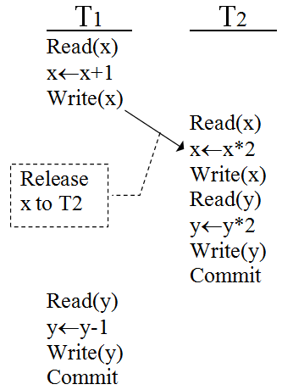
Problem with Basic LM - Example
Initial: x = 50 y = 20
Result of above scheduling:
x = 102 y = 39
Result of schedule {T1,T2}:
x = 102 y = 38
Result of schedule {T2,T1}:
x = 101 y = 39
Basic LM algorithm may generate non-serializable schedule!

Slide 22
Problem with Basic LM Algorithm
Early release of data
Solution ?

Slide 23
Two­ Phase Locking (2PL)
A transaction locks an object before using it.
When an object is locked by another transaction, the requesting transaction must wait.
When a transaction releases a lock, it may not request another lock.

Slide 24
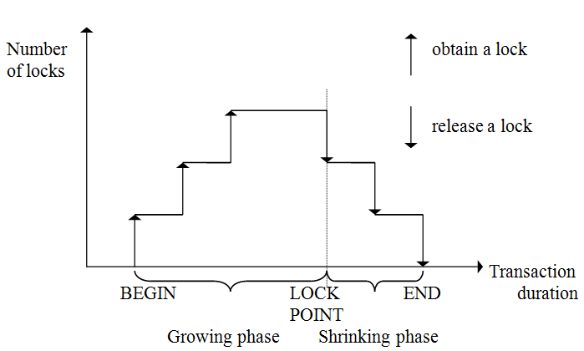
Two-Phase Locking (2PL)
Note: (1) 2PL is serializable; (2) Lock point is hard to determine;
(3) 2PL can cause cascading aborts!

Slide 25
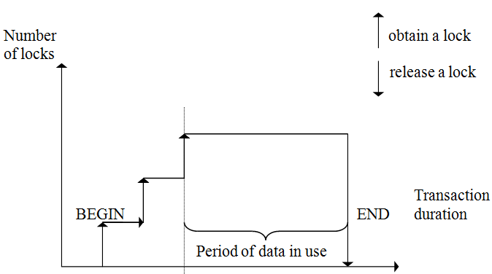
Strict 2PL (S2PL)
Hold locks until the end of transaction.
S2PL is serializable.
S2PL requires minimal modification to 2PL algorithm.

Slide 26
Centralized 2PL
A method to delegate lock management responsibility to a single site only (known as
primary 2PL algorithm)
  Coordinating TM
  The TM at the site where the transaction is initiated.
  Participating sites
  Those at which database operations are to be carried out.

Slide 27
One Central Lock Manager
There is only one 2PL scheduler in the distributed system.
Lock requests are issued to the central scheduler.
Data Processors at
participating sites
Coordinating TM
Central Site LM
Lock Request
Lock Granted
Operation
End of Operation
Release Locks

Slide 28
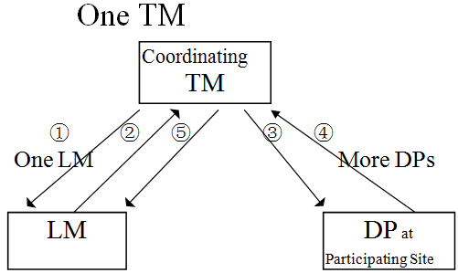
Communication Structure of Centralized 2PL
Messages:
Lock request
Lock granted
Database operation
End of database operation
Release locks
Problems -
poor performance and reliability

Slide 29
Primary Copy 2PL
Implement lock management at a number of sites and make each lock manager responsible for a set of lock units.
A dictionary is needed to keep the allocation of lock managers information.
Changes from centralized 2PL to primary copy 2PL are minimal.

Slide 30
Distributed 2PL
There is a lock manager at every site.
Each lock manager handles lock requests for data at that site.
Concurrency control is accomplished by the cooperation of lock managers at the sites where data are involved in the set of transactions.

Slide 31
Distributed 2PL Execution
Coordinating TM
Participating LMs
Participating DPs
Lock Request
Operation
End of Operation
Release Locks

Slide 32
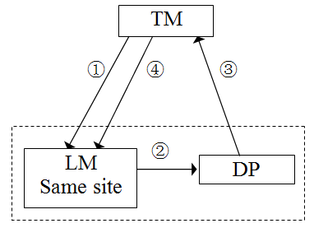
Communication Structure of Distributed 2PL
Messages:
Lock request
Lock granted
End of database operation
Release Lock
Differences between centralized 2PL and distributed 2PL can be observed by looking at their communication structures.

Slide 33
Differences between centralized and distributed 2PL
Centralized 2PL
Distributed 2PL
Lock request
Lock granted
Database operation
End of database operation
Release locks
Lock request
Lock granted
End of database operation
Release Lock

Slide 34
Distributed 2PL Execution
A transaction may read any of the replicated copies of item x by obtaining a read lock on one of the copies of x. Writing into x requires obtaining write locks for all copies of x
-- Read One Write All protocol

Slide 35
Summary of 2PL Locking
Centralized: One site does all locking
  Vulnerable to single site failure
Primary Copy: All locking for an object done at the primary copy site for this object
  Reading requires access to locking site as well as site where the object is stored
Distributed: Locking for a copy done at site where the copy is stored
  Locks at all sites while writing an object (Read One Write All)

Slide 36
Timestamp-based Concurrency Control Algorithms
Lock method maintains serializability by mutual exclusion.
Timestamp method maintains serializability by assigning a unique timestamp to every transaction and executing transactions in order.

Slide 37
Timestamp of Transaction
Transaction manager assigns a globally unique timestamp ts(Ti) to transaction Ti
Transaction manager attaches the timestamp to all operations issued by the transaction.
Timestamp can be used to permit ordering
Monotonicity -- timestamps generated by the same TM monotonically increase in value.

Slide 38
How to Assign a Timestamp Value?
Use a monotonically increased counter, but this is difficult in a distributed environment.
Use a two-tuple form:
<local-counter-value, site-identifier>
Use another two-tuple form:
<local-system-clock, site-identifier>
site ID is put in the least significant position
to avoid the situation that timestamps from a site will always be larger/smaller than timestamps from another site.

Slide 39
Timestamp Ordering (TO) Rule
Given two conflicting operations O_{ij}(x) and O_{kl}(x) belonging to transaction T_{i} and T_{k} respectively,
O_{ij}(x) is executed before O_{kl}(x)
if and only if ts(T_{i}) < ts(T_{k})
i.e., the older transaction gets executed first.

Slide 40
Schedule by the TO Rule
Basic procedure:
Check each new operation against conflicting operations that have been scheduled;
IF the new operation belongs to a younger (later) transaction than all conflicting ones THEN
  accept it;
ELSE
  reject it;
  restart the entire transaction with a new timestamp.
This means the system maintains the execution order according to the timestamp order.

Slide 41
Basic TO Algorithm
Conflicting operations are resolved by timestamp order.
To facilitate easy checking whether some transaction with a larger timestamp has already accessed a data item, each data item is assigned a write timestamp (wts) and a read timestamp (rts):
  rts(x) = largest (youngest) timestamp of any read on x
  wts(x) = largest (youngest) timestamp of any write on x

Slide 42
Basic TO Algorithm (cont.)
for Ri(x): for Wi(x):
if ts(Ti) < wts(x) if ts(Ti) < rts(x) or
ts(Ti) < wts(x)
then reject Ri(x) then reject Wi(x)
else accept Ri(x) else accept Wi(x)
rts(x) ←ts(Ti) wts(x) ←ts(Ti)

Slide 43
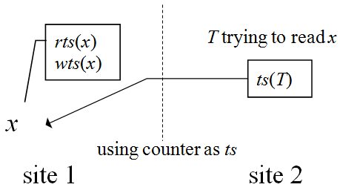
Maintain Timestamps Among Sites
When ts(T) < wts(x), the read is rejected.
Site 2 adjusts its timestamp by making it larger than wts(x) and restart.
Avoid ts(site 1) >> ts(site 2) which may make operations from site 2 never get executed.

Slide 44
Conservative TO Algorithm
Basic TO algorithm
  deadlock free but too many restarts.
Conservative TO algorithm
  Reduce the number of restarts;
  delay each operation until there is an assurance that no operation with smaller timestamps can arrive at that scheduler.

Slide 45
Conservative TO Technique
At site i, each scheduler i has one queue Q_{ij} for each TM at site j in the system.
An operation from TM_{j} is placed in Q_{ij} in increasing timestamp order.
Scheduler i executes operations from all queues in this order also.
This reduces the number of restarts. But
restart may occur when a queue is empty..

Slide 46
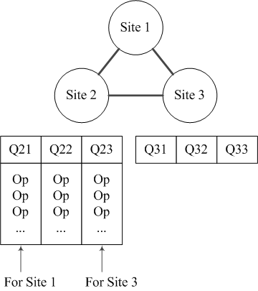
Conservative TO Technique (cont.)
Suppose Q23 is empty and scheduler 2 chooses an operation op from Q21 and Q22.
But later a conflicting operation with smaller timestamp than ts(op) from site 3 arrives, then this operation must be rejected and restarted!
Improvement ?

Slide 47
Improvement 1
Use extremely conservative algorithm, complemented by
  In each queue, there is at least one operation, or
  if a TM does not have a transaction to process, it has to send a message periodically to inform that in the future it will send timestamp larger than that of the message.
  Problems:
Extremely conservative algorithm actually executes transaction serially at each site – too conservative !
An operation may have to wait for the coming of a younger operation of an empty queue – a delay problem !

Slide 48
Improvement 2
Define transaction classes and set a queue for each class instead of each TM
  Transaction classes are defined by their read set and write set:
  If a transaction’s read set and write set are subset of a class, then the transaction belongs to that class.
  Difficulty:
It is difficult to define transaction classes!

Slide 49
Multiversion TO Algorithm
To eliminate restart overhead costs
Updates do not modify the database; each write creates a new version of the data item to be updated.
Versions are transparent to users.
Transactions are processed on a state of database that it would have seen if they were executed serially.

Slide 50
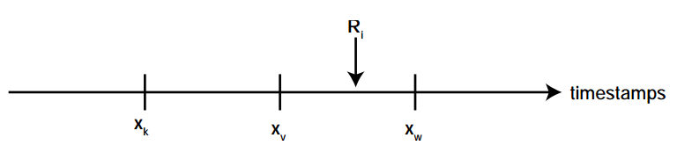
Work of the Scheduler
For a read R_{i}(x) from transaction T_{i}:
Find a version of x (say x_{v}) such that
ts(x_{v}) is the largest timestamp less than ts(T_{i});
Send R_{i}(x_{v}) to the data processor.

Slide 51
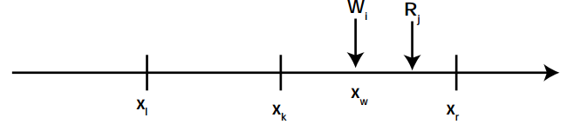
Work of the Scheduler (cont.)
For a write W_{i}(x) from transaction T_{i} :
A W_{i}(x) is translated into W_{i}(x_{w}) so that ts(x_{w})=ts(T_{i}) and (accepted) sent to the data processor,
if and only if no other transaction with a timestamp greater than ts(T_{i}) has read the value of a version of x (say x_{r}) such that ts(x_{r})>ts(x_{w}) .

Slide 52
Work of the Scheduler (cont.)
This scheduler generates serializable schedule.
Versions may be purged when they are not accessed by any transactions.

Slide 53
Deadlock
A transaction is deadlocked if it is blocked and will remain blocked until there is intervention.
Locking­ based CC algorithms may cause deadlocks.
TO­ based algorithms that involve waiting may cause deadlocks.
Wait­For Graph (WFG)
  If transaction T_{i} waits for another transaction T_{j} to release a lock on an entity, then T_{i} → T_{j} in WFG.
Ti
Tj

Slide 54
Local versus Global WFG
Assume T₁ and T ₂ run at site 1, T ₃ and T ₄ run at site 2.
Assume T ₃ waits for a lock held by T ₄ which waits for a lock held by T ₁ which waits for a lock held by T₂ which, in turn, waits for a lock held by T₃ .
Local WFG Global WFG
Site 1
Site 2
Site 1
Site 2
T₁
T₄
T₁
T₄
T₂
T₃
T₂
T₃

Slide 55
Deadlock Management
Ignore
  Let the application programmer deal with it, or restart the system
Prevention
  Guarantee that deadlocks can never occur in the first place. Check transaction when it is initiated. Require no run time support.
Avoidance
  Detect potential deadlocks in advance and take action to ensure that deadlock will not occur. Require run time support.
Detection and Recovery
  Allow deadlocks to form and then find and break them. Require run time support.

Slide 56
Deadlock Prevention
All resources which may be needed by a transaction must be pre-declared.
  The system must guarantee that none of the resources will be needed by an ongoing transaction.
  Resources must only be reserved, but not necessarily allocated a priori.
  Unsuitability in database environments
  Suitable for systems that have no provisions for undoing processes.
Evaluation
  - Reduced concurrency due to pre-allocation
  - Evaluating whether an allocation is safe leads to added overhead.
  - Difficult to determine
  + No transaction rollback or restart is involved.

Slide 57
Deadlock Avoidance
Transactions are not required to request resources a priori.
Transactions are allowed to proceed unless a requested resource is unavailable.
In case of conflict, transactions may or may not be allowed to wait for a fixed time interval.
Order either the data items or the sites and always request locks in that order.
More attractive than prevention in a database environment.

Slide 58
Deadlock Avoidance - Wait­Die
If T_{i} requests a lock on a data item which is already locked by T_{j}, then T_{i} is permitted to wait iff ts(T_{i})<ts(T_{j}).
If ts(T_{i})>ts(T_{j}), then T_{i} is aborted and restarted with the same timestamp.
  if ts(T_{i})<ts(T_{j}) then T_{i} waits else T_{i} dies
  non­ preemptive: T_{i} never preempts T_{j}
  younger transaction is aborted

Slide 59
Deadlock Avoidance - Wound­Wait
If T_{i} requests a lock on a data item which is already locked by T_{j}, then T_{i} is permitted to wait iff ts(T_{i}) >ts(T_{j}).
If ts(T_{i})<ts(T_{j}), then T_{j} is aborted and the lock is granted to T_{i}.
  if ts(T_{i})<ts(T_{j}) then T_{j} is wounded else T_{i} waits
  preemptive: T_{i} preempts T_{j}
  younger transaction is aborted

Slide 60
Deadlock Detection
Transactions are allowed to wait freely.
Wait­for graphs and cycles.
Topologies for deadlock detection algorithms
  Centralized
  Hierarchical
  Distributed

Slide 61
Centralized Deadlock Detection
One site is designated as the deadlock detector for the system. Each scheduler periodically sends its local WFG to the central site which merges them to a global WFG to determine cycles.
How often to transmit?
  Too often: higher communication cost but lower delays due to undetected deadlocks
  Too late: higher delays due to deadlocks, but lower communication cost
A reasonable choice if the concurrency control algorithm is also centralized.

Slide 62
Hierarchical Deadlock Detection
Organize sites into a hierarchy and deadlock detectors (DD) send local graphs to parent in the hierarchy
Level 0
DD_{0x}
Level 1
DD₁₁
DD₁₄
Site 3
Site 1
Site 2
Site 4
DD₂₁
DD₂₂
DD₂₃
DD₂₄
Level 2
Building a hierarchy of deadlock detectors

Slide 63
Distributed Deadlock Detection
Sites cooperate in detection of deadlocks
The local WFGs are formed at each site and passed on to other sites.
Each local WFG is modified as follows:
  Since each site receives the potential deadlock cycles from other sites, these edges are added to the local WFGs
  The edges in the local WFG which show that local transactions are waiting for transactions at other sites are joined with edges in the local WFGs which show that remote transactions are waiting for local ones.

Slide 64
Distributed Deadlock Detection (cont.)
Each local deadlock detector
  looks for a cycle that does not involve the external edge. If it exists, there is a local deadlock which can be handled locally.
  looks for a cycle involving the external edge. If it exists, it indicates a potential global deadlock. Pass on the information to the next site.

Slide 65
Question & Answer

